Slide 1
United Kingdom Economic Outlook
ECON 211A, Biwei Chen, Spring 2022
MyaKay Bartman, Houghton College, myakay.bartman25@houghton.edu, March 21
1

Slide 2
Table of Contents
National Income and Growth 3
Labor Market Condition 4 - 6
Price Market and Inflation 7
Money and Interest Rates 8
Financial Markets 9
References 10
2

Slide 3
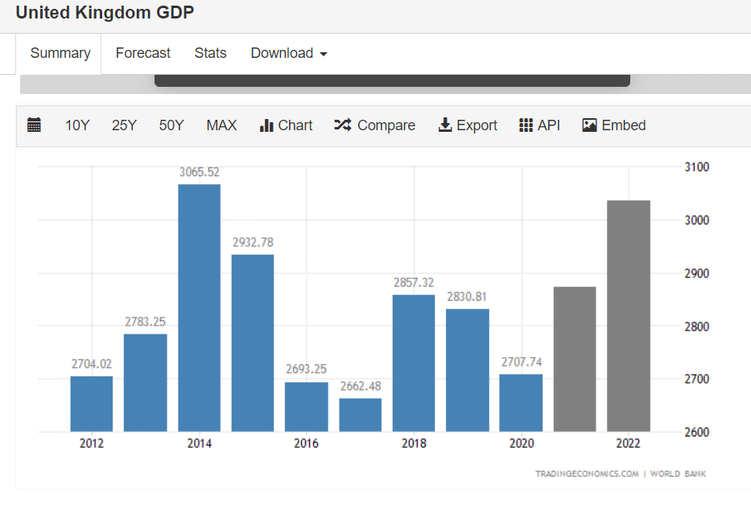
National Income and Growth
2020-2021 income
£759 billion
Expected 2021-2022 income
£862 billion
https://obr.uk/forecasts-in-depth/brief-guides-and-explainers/public-finances/#:~:text=In%202021%2D22%2C%20we%20expect%20public%20spending%20to%20amount%20to,many%20different%20types%20of%20spending.
Economic Growth (annually)
2020: -9.8%
2021: 6.9%
2022: 4.7%
https://www.oecd.org/economy/united-kingdom-economic-snapshot/
https://tradingeconomics.com/united-kingdom/gdp
3

Slide 4
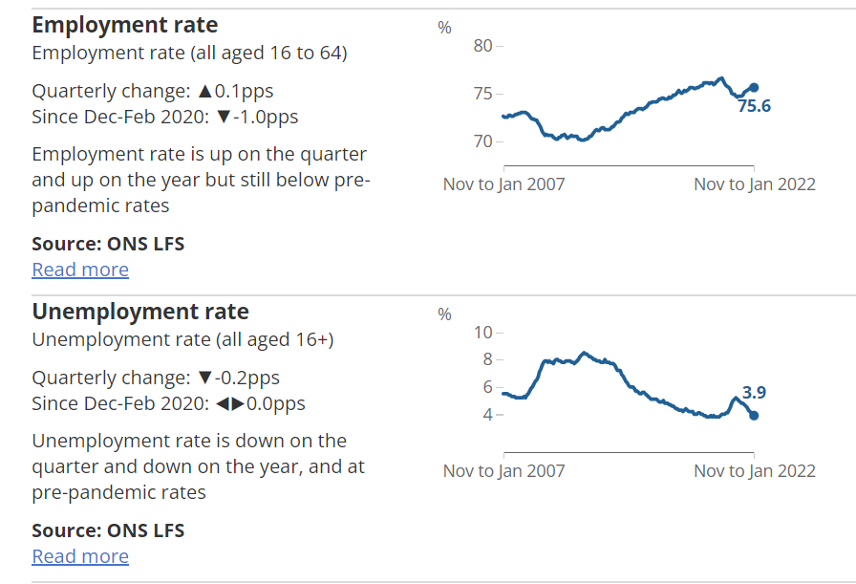
Labor Market Conditions
Start of 2022 - 29.5 million employees
Employment Rate: 75.6%
Unemployment Rate: 3.9%
https://www.ons.gov.uk/employmentandlabourmarket/peopleinwork/employmentandemployeetypes/bulletins/uklabourmarket/march2022
4

Slide 5
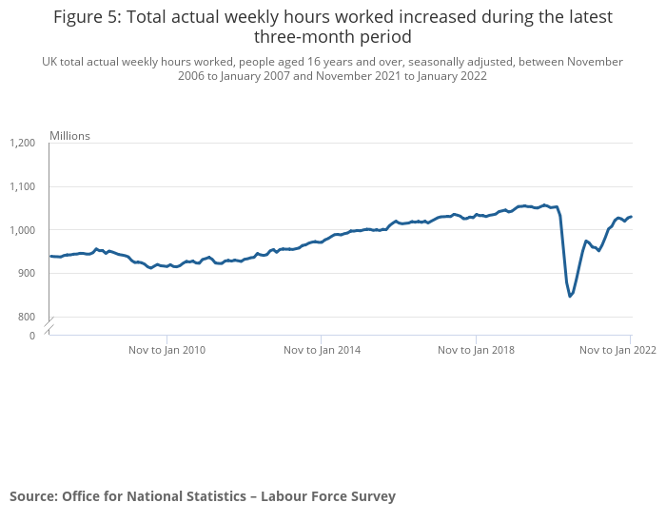
Labor Market Conditions
In 2022
Total hours worked weekly: 1,029 hrs
Employees 16+
In 2020
Total hours worked weekly: 845 hrs
Growth in Average Pay (from 2021): 4.9%
~ £31,285 annual income
https://www.statista.com/statistics/1002964/average-full-time-annual-earnings-in-the-uk/
https://www.ons.gov.uk/employmentandlabourmarket/peopleinwork/employmentandemployeetypes/bulletins/employmentintheuk/latest
5

Slide 6
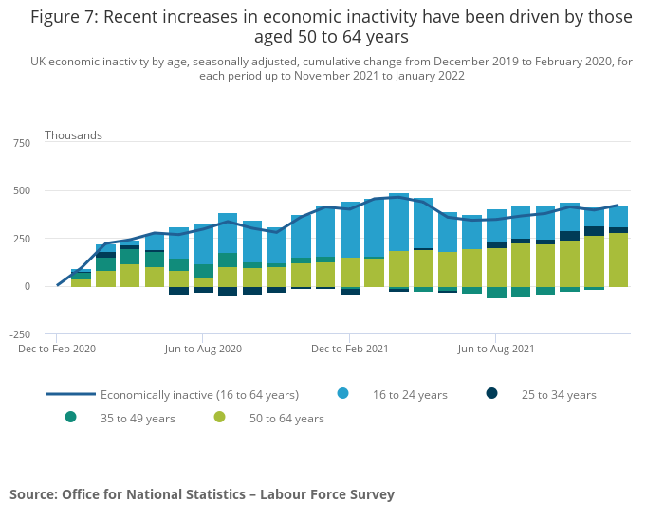
Labor Market Conditions
Labor Market Inactivity
Total Inactive: 420,000 people
Most inactive: 50 - 64 years old
Next most inactive: 16 - 24 years old
https://www.ons.gov.uk/employmentandlabourmarket/peopleinwork/employmentandemployeetypes/bulletins/employmentintheuk/latest
6

Slide 7
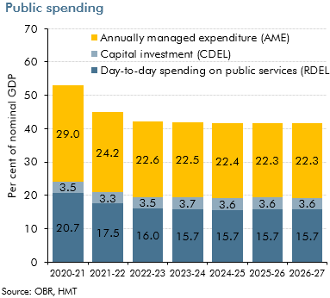
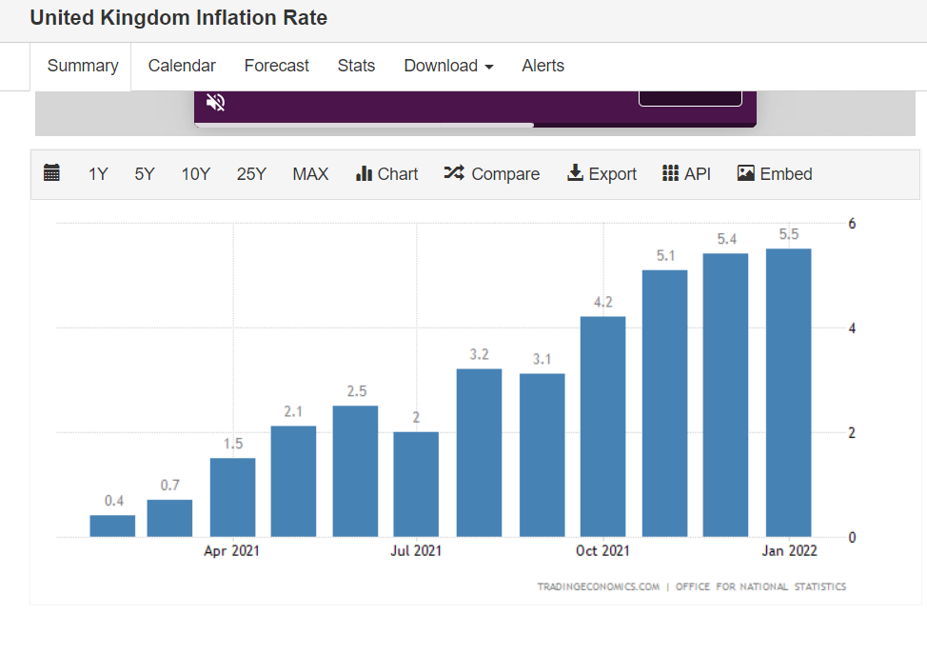
Price Market and Inflation
Inflation Rate: 5.5%
Highest since 1992
Expected to decrease in upcoming years
Public Spending: £1,045 billion
Health
Education
Defense
Expected to increase in upcoming years
https://tradingeconomics.com/united-kingdom/inflation-cpi#:~:text=Inflation%20Rate%20in%20the%20United,percent%20in%20April%20of%202015.
https://obr.uk/forecasts-in-depth/brief-guides-and-explainers/public-finances/#:~:text=In%202021%2D22%2C%20we%20expect%20public%20spending%20to%20amount%20to,many%20different%20types%20of%20spending.
7

Slide 8
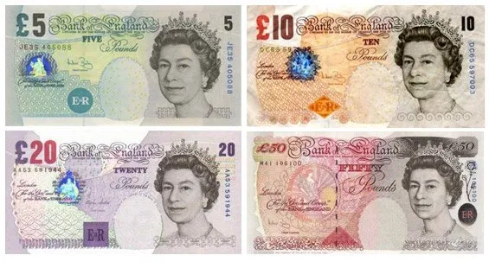
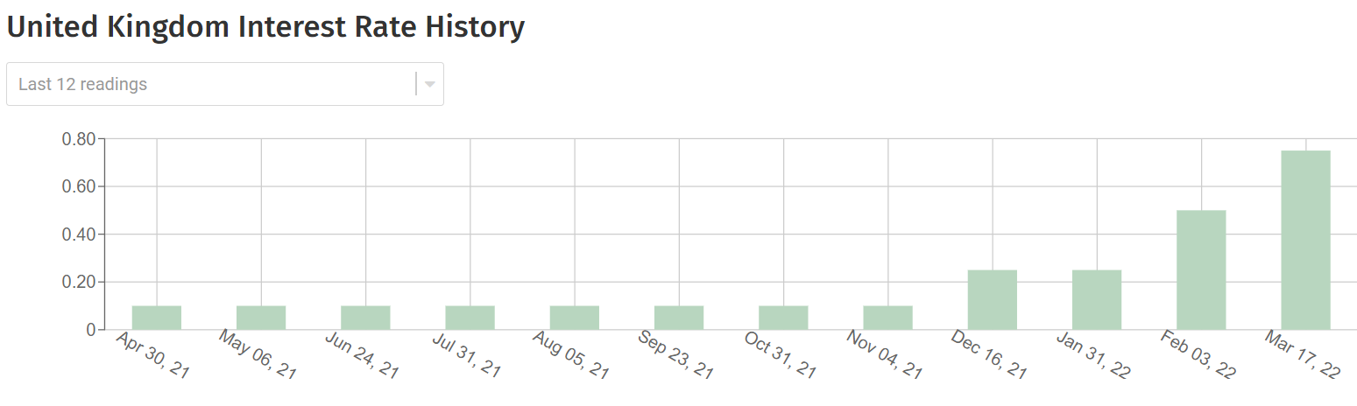
Money and Interest Rates
Currency: Pound Sterling (£)
One £ = 1.32 US Dollar
Interest Rate: 0.75%
Bank Rate: 0.75%
Interest rate of commercial banks
Recently increased by 0.25%
https://www.londoncitybreak.com/currency
8
Notes:
Raised to tackle covid expenses

Slide 9
Financial Markets
6th largest largest economy in the world in terms of nominal GDP
$2.708 trillion
3rd share of global equity markets by country
world’s largest foreign exchange (forex) market
Turnover of $3.6 million
https://www.statista.com/topics/7536/financial-markets-in-the-uk/#dossierKeyfigures
9

Slide 10
References
“A Brief Guide to the Public Finances.” Office for Budget Responsibility, 21 Dec. 2021, https://obr.uk/forecasts-in-depth/brief-guides-and-explainers/public-finances/#:~:text=In%202021%2D22%2C%20we%20expect%20public%20spending%20to%20amount%20to,many%20different%20types%20of%20spending.
“Currency in London - Money Used in London and in the UK.” London by CIVITATIS, https://www.londoncitybreak.com/currency.
Published by D. Clark, and Nov 15. “Full-Time Annual Salary in the UK 2021.” Statista, 15 Nov. 2021, https://www.statista.com/statistics/1002964/average-full-time-annual-earnings-in-the-uk/.
Statista. “Topic: Financial Markets in the UK.” Statista, https://www.statista.com/topics/7536/financial-markets-in-the-uk/#dossierKeyfigures.
“United Kingdom Economic Snapshot.” OECD, https://www.oecd.org/economy/united-kingdom-economic-snapshot/.
“United Kingdom GDP2021 Data - 2022 Forecast - 1960-2020 Historical - Chart - News.” United Kingdom GDP - 2021 Data - 2022 Forecast - 1960-2020 Historical - Chart - News, https://tradingeconomics.com/united-kingdom/gdp.
“United Kingdom Inflation Ratefebruary 2022 Data - 1989-2021 Historical.” United Kingdom Inflation Rate - February 2022 Data - 1989-2021 Historical, https://tradingeconomics.com/united-kingdom/inflation-cpi#:~:text=Inflation%20Rate%20in%20the%20United,percent%20in%20April%20of%202015.
“United Kingdom Interest Rate.” United Kingdom Interest Rate 1971-2022, https://www.fxempire.com/macro/united-kingdom/interest-rate.
Watson, Bob. “Employment in the UK: March 2022.” Employment in the UK - Office for National Statistics, Office for National Statistics, 15 Mar. 2022, https://www.ons.gov.uk/employmentandlabourmarket/peopleinwork/employmentandemployeetypes/bulletins/employmentintheuk/latest.
10

